Slide 1
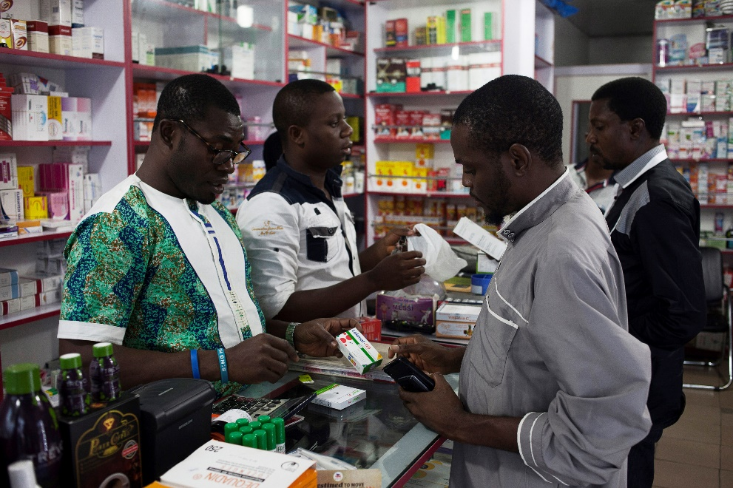

[Country, Year]
Practice Interviews
Notes:
Please personalize this slideshow with any details specific to your organization/project.

Slide 2
Interview guide review
Walk through the interview guide as a group (led by training facilitator).
Ensure all participants understand the questions.
Identify any sources of confusion and address them in the moment.
Have the group identify questions that may cause confusion among participants.
Brainstorm approaches to explaining these questions.

Slide 3
Key considerations for practice
Balance following the guide and knowing when to dive deeper.
Stay neutral & let participants share their stores.
Keep track of pace and time (interview should take ~45-90 minutes).

Slide 4
Mock Interview
Watch for:
Rapport building
What did the interviewer do to build rapport (introductions, ice breaker, body position, etc.)?
Does the respondent appear to be comfortable sharing their story?
Active listening
How did the interviewer indicate that they were listening?
Are there ways the interviewer’s active listening could have been improved?
Probing
How did the interviewer probe?
Were there opportunities for probing that the interviewer missed?
Notes:
Facilitators to demonstrate a practice interview, with trainees watching and integrating in lessons from the prior modules

Slide 5
Practice!
This is an opportunity to learn from each other; all feedback should be respectful and constructive!
Pair up.
Select one person to be the interviewer and the other as the interviewee (we’ll swap roles next round).
Complete the interview guide (be sure to probe and allow for flexibility).
Interviewees should be prepared to evaluate the interviewer for:
Familiarity with interview tool
Rapport building
Active listening
Probing
Overall performance conducting the interview
Notes:
Julius and Eden – as interviewees and to take notes

Slide 6

[Country, Year]
End of session
Thank you for your attention!
Any questions?

